Slide 1
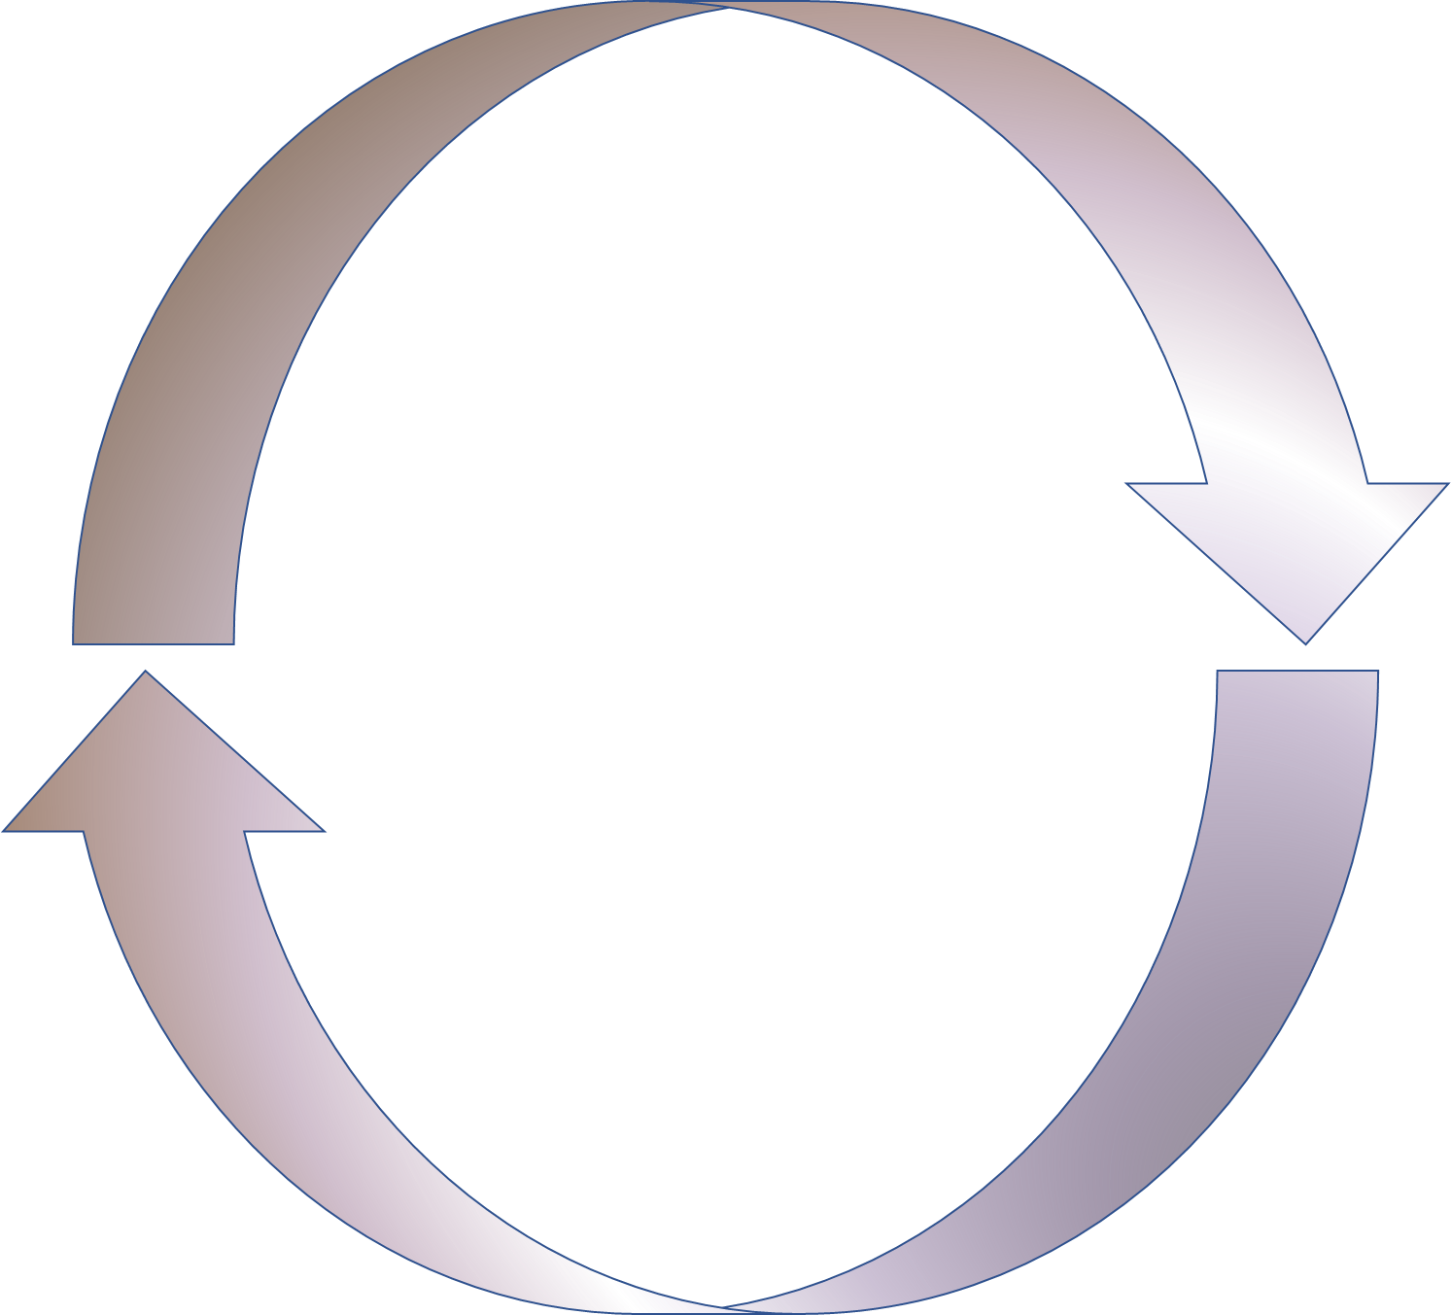
Introduction to Causal Modeling with Time Series
April 16, 2025
Dr. Kimberly Thompson
Postdoctoral Researcher
German Centre for Integrative Biodiversity Research
Kimberly.thompson@idiv.de

Slide 2
Today’s Plan
9:00 AM - ~4:00 PM
Morning Session
Lecture: Introduction to Empirical Dynamic Modeling and Convergent Cross Mapping
Theory, Implementation, Data considerations, and Applications
Small break
R-tutorial: Convergent Cross Mapping with rEDM
Lunch from 12:00 – 1:00
Afternoon Session
Finish R tutorial from morning session (if necessary)
Lecture: Introduction to S-mappping
R tutorial: S-mapping
Feedback and Questions

Slide 3
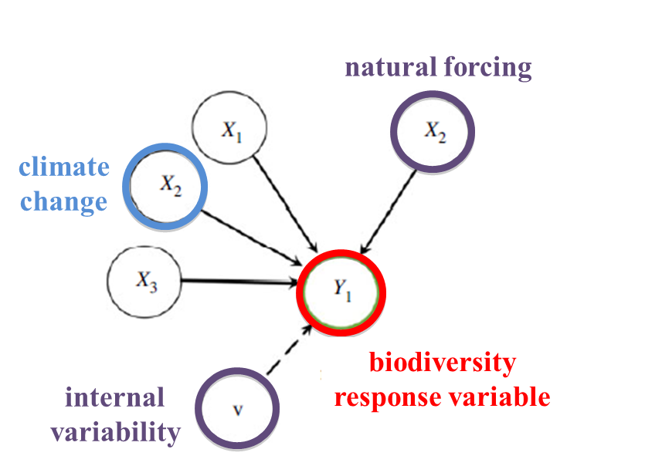
Traditional Approaches
Climate
Land use/land cover
NDVI
Fluxes
Productivity
Resource Availability
Abundance
Biomass
Land cover
NDVI
Fluxes
Productivity
Resource Availability
Gonzalez et al. 2023
Notes:
My research focus is on biodiversity change, so when I think about focal variables where I would like to understand what is driving them, I think of biodiversity-related responses like abundance and biomass, but really we can think about understanding the causes of a wide variety of variables that we might encounter in environmental sciences.
Regardless of what we plug in for Y, we need to take into consideration the internal variability and natural forcing of whatever system we’re investigating, because these could distort how we interpret the various drivers of the system. Note also that depending on what we’re researching, our causes could also be viewed as the effects and vice versa.
Many scientific fields use models as approximations of reality and for purposes like testing hypotheses regarding mechanisms or processes, explaining past observations, predicting future outcomes.
In most cases these models are based on hypothesized parametric equations; and the results provide a measure of association among the variables.
Also the well known adage correlation does not mean causation
Plus the lesser known other way – causation does not necessarily mean correlation

Slide 4
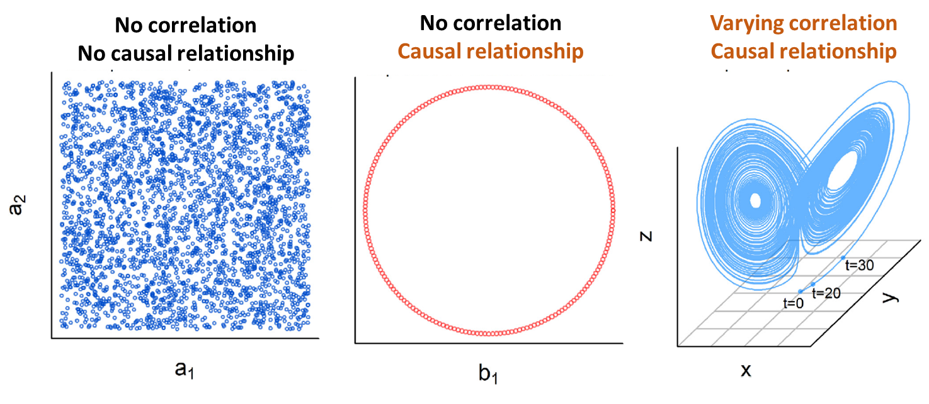
Traditional Approaches
Medina et al. 2022
Notes:
When we try to infer causality from traditional parametric models, it can lead to spurious conclusions for several reasons.
Sometimes we have no correlation and no causal relationship, but there are other instances where two variables could be dependent on one another and display no correlation. Similarly we could also have a system where the variables are dependent on one another but they show varying correlations, so positive in some cases, negative in others, or none at all.

Slide 5
Empirical Dynamic Modeling
Non-parametric
No underlying assumptions about the distribution of the data
No hypothesized equations about how variables are related
Provides a flexible alternative when we have time series data
Notes:
Before we think about the other things we have to consider when applying this method, it’s important to start with a little theory to get a better understanding of what exactly we’ll be doing…

Slide 6
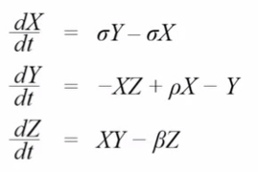
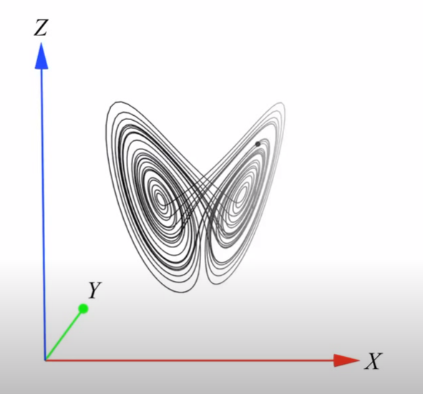
Theoretical Foundation
System described by 3 equations
Each component depends on the state and dynamics of the other two components
State space
Manifold
Attractor
Dynamical system
Notes:
We have a system here described by 3 equations.
Now the equations themselves aren’t important, what is important is to see that each component of the system depends on the other two.
And we can construct a visualization of this called a state space, which simply means a multidimensional space that represents our dynamical system.
Why do we call it a dynamical system? Because at each point in time --- and not that time is not represented on any axis here, but we can see time’s behavior in the trajectory of the system --- the state of the system changes.

Slide 7
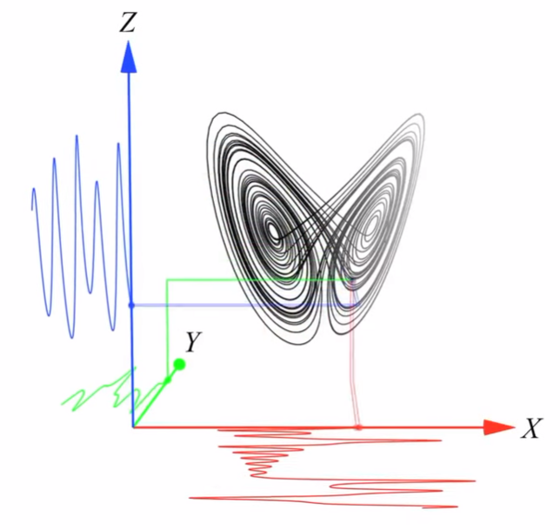
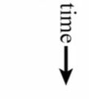
Theoretical Foundation
We can project the dynamics of the system onto coordinate axes
Provides time series of each variable in the state space
Notes:
We can incorporate time more explicitly, by examining how each individual component changes through time. So now we are projecting the dynamics of the system onto coordinate axes, which provides a time series of each variable in the state space.
We can also imagine reversing this process where perhaps we start with a set of time series and use them to reconstruct the state space.

Slide 8
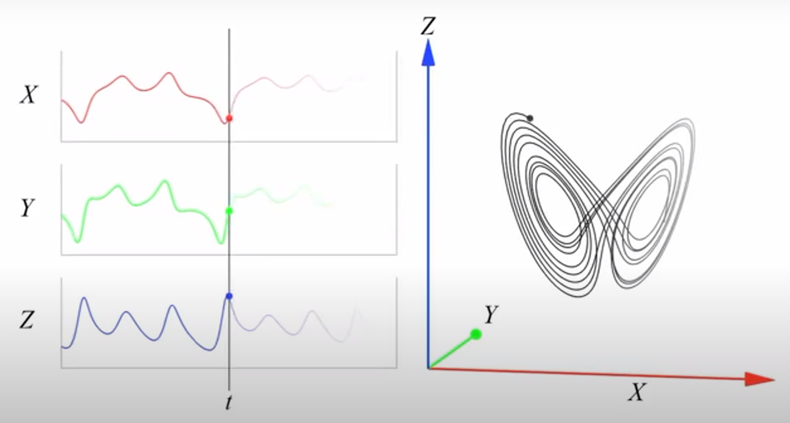
Theoretical Foundation
State-space reconstruction
We can also reconstruct the dynamics from each time series
Notes:
We can also imagine reversing this process where perhaps we start with a set of time series and use them to reconstruct the state space.

Slide 9
Theoretical Foundation
Dynamical system = State-dependent system
Relationships among variables change with different states of the system
Variables are interdependent and cannot be analyzed separately
Empirical dynamic modeling
Rooted in the idea that we can reconstruct the state space from time series
Does not assume that any set of equations governs the system
Recovers the dynamics of the system from the time series data
But what if we have only observed one component of a system?
Notes:
So let’s reiterate
But we often are faced with the situation where maybe we do not have observations for all the variables we think are in a system? What to do then? What if we only have observed one component of a system?

Slide 10
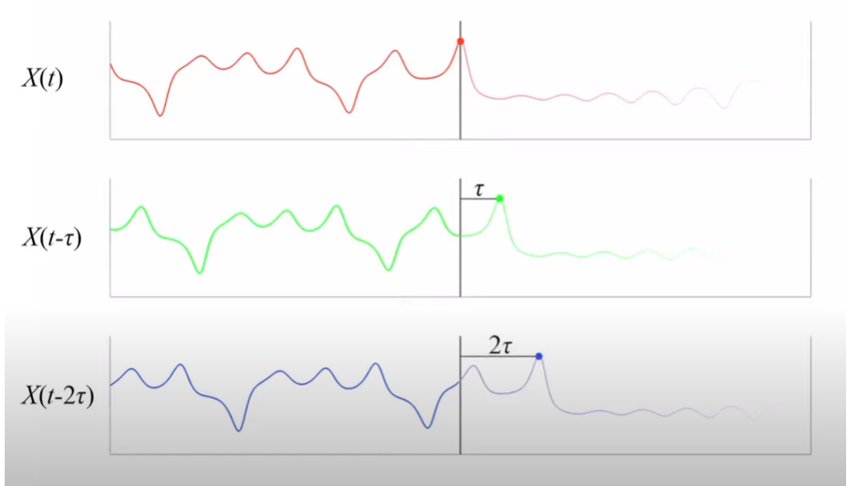
Takens’ Theorem
We can reconstruct a shadow version of the original manifold with only one of the time series from the system
Lagged versions of the time series
Notes:
Floris Takens developed a theory that can help us in this regard.
The theorem says that we can reconstruct a shadow version of the original system with only one of the time series from the system using lagged versions of the time series.
So in these 3 time series shown here, all are copies of the time series X, but just displaced by different amounts according to tau. So the red series is unlagged, the green series is displaced by tau, and the blue series is displaced by 2 tau.

Slide 11

Takens’ Theorem
Reconstructing the original system
Reconstruction preserves essential mathematical properties
Represents a 1:1 mapping between the original system and the reconstructed system
We can recover states of the original dynamic system by using lags of just a single time series without any other assumptions
Why does this work?
Because time series are sequential observations of the system behavior, information about the rules that govern system behavior is therefore encoded in each time series.
Notes:
So when we map these lagged time series back into the state space, we end up with a shape that is quite close to the original manifold.
Preserved essential mathematical properties like the topology
It represents a 1:1 mapping between the original system and the reconstruction which means that we can recover the states of the original dynamic system by using lags of just a single time series without any other assumptions about how the system behaves.
Reconstructed manifold is then the library or the collection of the historical behavior of the lags.
1:1 mapping = topological invariance

Slide 12
When wouldn’t this work?
When the system does not require a high-dimensional space to describe its dynamics
Given the complexity of most aspects of the world, the majority of systems in ecology, environmental sciences, economics, etc. require a high-dimensional space to adequately capture system dynamics
When the system is purely stochastic
Variables in the state space must have some kind of deterministic relationship and not be solely random
When the system is linear
Typically, if a system requires a high-dimensional space to describe it’s dynamics, it would not be linear; however, it’s worth emphasizing that EDM is designed for nonlinear dynamical systems
Notes:
There are many applications of empirical dynamic modeling but today we’re going to focus on just one which is identifying causal interactions.

Slide 13
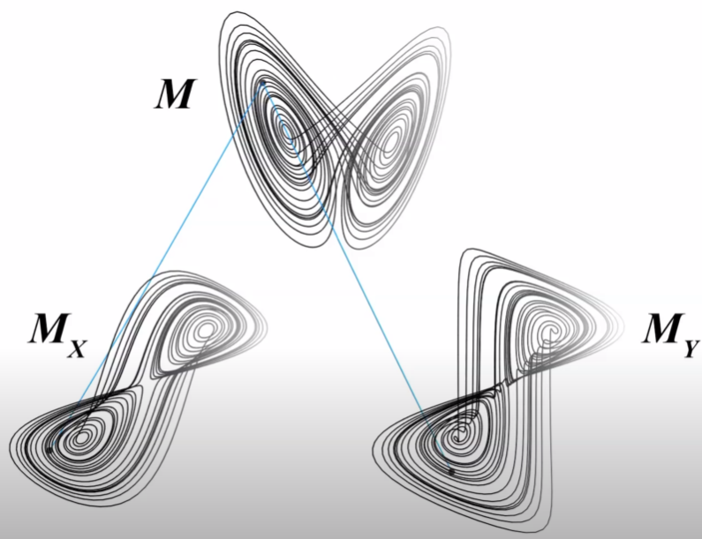
Theoretical Foundation
Another reconstruction using Y
Both M_{X} and M_{Y} map 1:1 to M
This means that M_{X} and M_{Y} also map 1:1 to each other
Points that are nearby on M_{Y} also correspond to points that are nearby on M_{X}
We can use this property of 1:1 mapping to determine if two time series variables come from the same dynamic system
and are thus CAUSALLY RELATED
Notes:
So we watched a reconstruction of the original manifold using variable X, if the same is done for variable Y we get something similar.
Because both the shadow version made using X and the shadow version made using Y map 1:1 to the original manifold, they also map 1:1 to each other.
This means that points that are nearby on the shadow version My correspond to points that are also nearby on Mx.
We can use this property (of 1:1 mapping) to determine if two time series variables come from the same dynamic system and are thus causally related.
This is the basis of the causal analysis technique called convergent cross mapping – so named because we’re cross mapping between system variables.

Slide 14
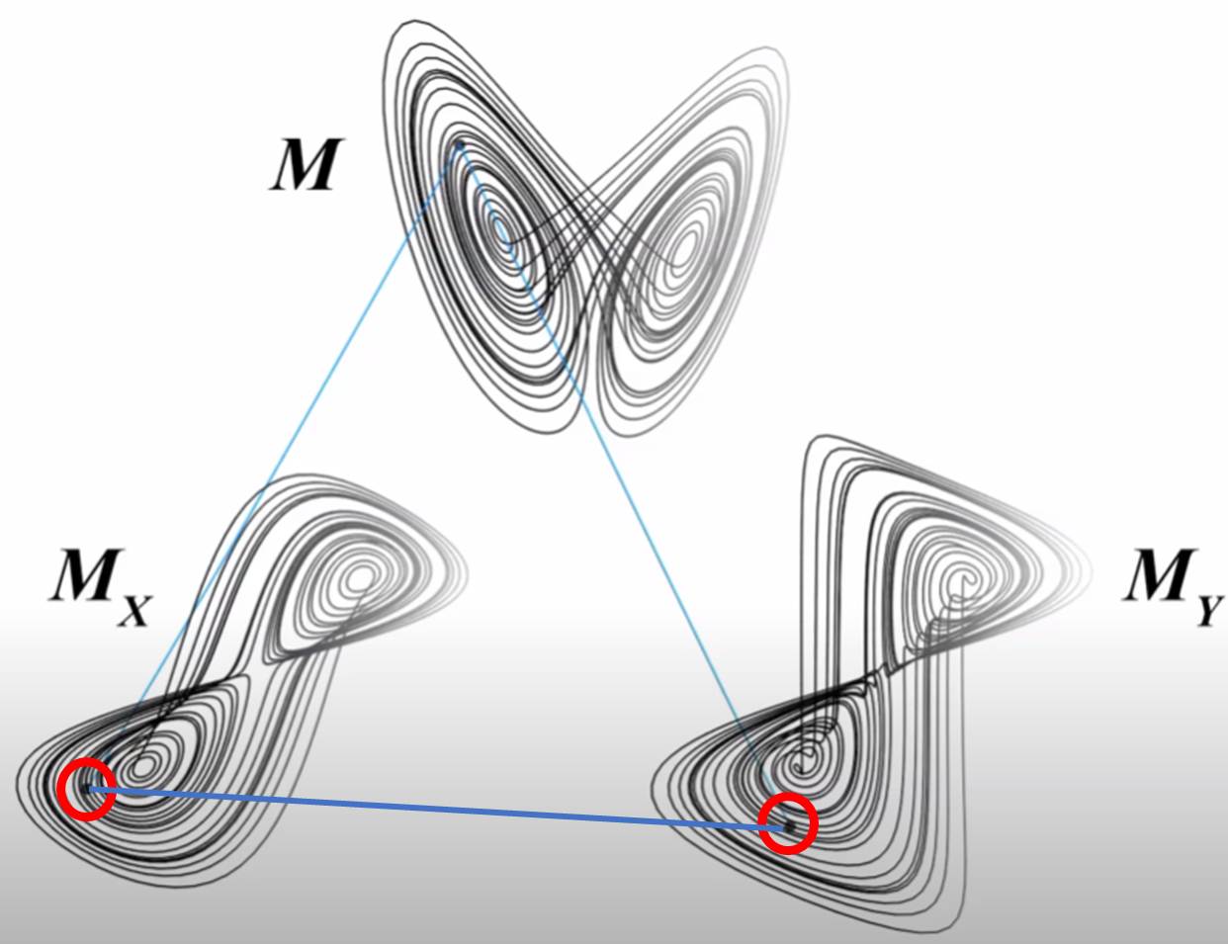
Convergent Cross Mapping
X → Y
Y time series (effect) contains information about the X time series (cause)
X (cause) can therefore be predicted from Y (effect)
How well do the nearest neighbors at a point on M_{y} predict the corresponding point on M_{x}?
The accuracy of this prediction can be used to assess causality
Notes:
So we’ll keep this image in mind to remind us of the 1:1 mapping since that’s the foundation of the method.
Then let’s explore what this means ---
The main idea is that if it’s true that X drives Y, then there should be a detectable signal of X the cause in the time series of Y, the effect.
Although it sounds a little bit counterintuitive, we should therefore be able to use the Y time series to predict X
So convergent cross mapping systematically searches for these signals of the cause time series in the time series of the effect using the lagged reconstructions and the nearest neighbors found at each point and detects causality based on how accurately we can predict the cause from effect..
Importantly we do not infer causation from correlation here but rather this method searches for shared patterns in the driver and response variables that based on a mathematical proof called Takens theorem can only exist if the two are causally related.

Slide 15
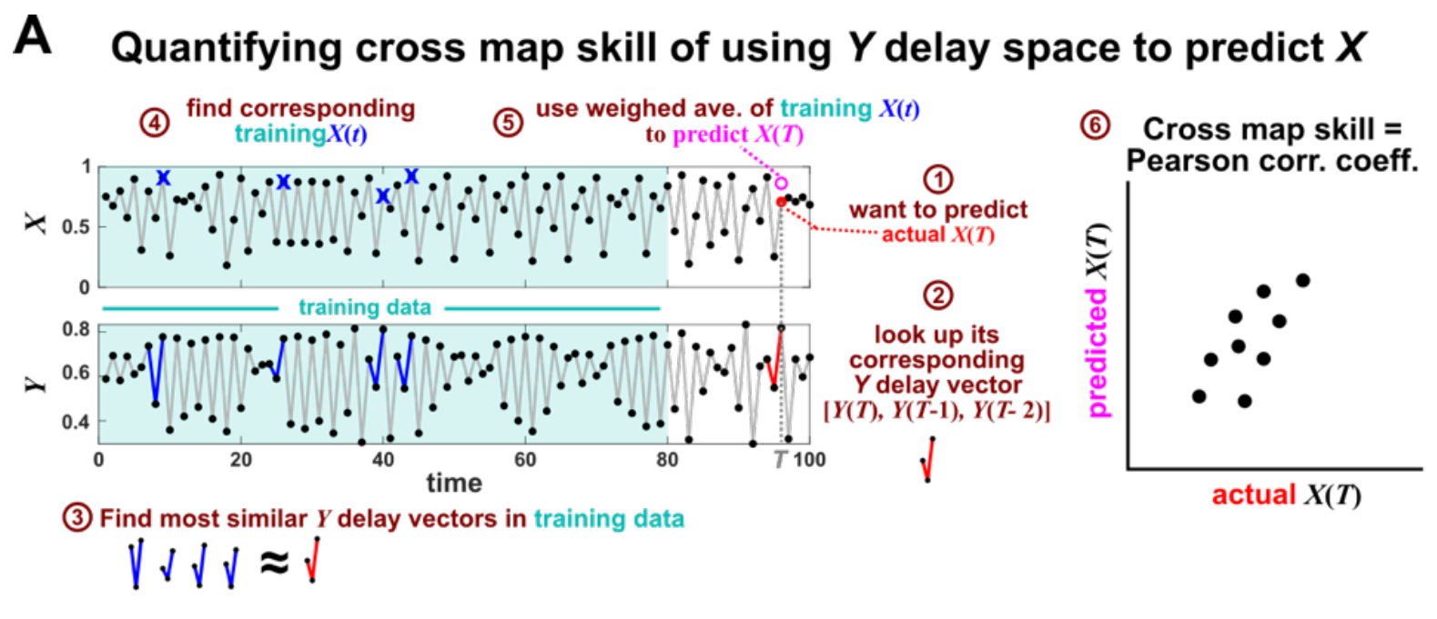
Convergent Cross Mapping
Yuan & Shou 2022
Notes:
How does this work in practice?
Figure 6: Illustration of the convergent cross mapping (CCM) procedure for testing whether X causes Y .
(A) Quantifying cross map skill. Consider the point X(T) denoted by the red dot (“actual X(T)” in ¨),
which we want to predict from Y delay vectors. We first look up the contemporaneous Y delay vector
([Y (T), Y (T − 1), Y (T − 2)]) (≠, red dynamics), and identify times within our training data when delay
vectors of Y were the most similar to our red delay vector (Æ, blue segments). We then look up their
contemporaneous values of X (Ø, blue crosses), and use their weighted average to predict X(T) (∞, open
magenta circle; weights are given as equations S2 and S3 in the supplement of [5]). We repeat this procedure
for many choices of T and calculate the Pearson correlation coefficient between the actual X(T) and predicted
X(T) (±). This correlation is called the “cross map skill”. While other measures of cross map skill, such
as mean squared error, may also be used [5], our choice follows the convention of [5].

Slide 16
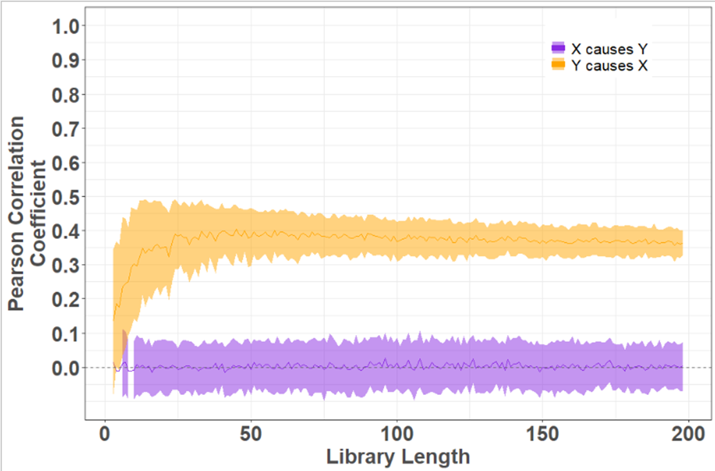
Convergent Cross Mapping
Predictive ability
Y
X
$$ρ$$
X
Y
We can determine the presence of causality and how much information from one process was found in the other
number of historical observations used to make predictions
Notes:
So we look at how well the hypothesized effect time series predicts the hypothesized cause time series using the Pearson correlation coefficient or rho, which in this case determines both the presence of causality and how much information from one process was found in the other
For a hypothetical causal system, Here we have the pearson correlation coefficient on the y-axis and the library length, which represents the number of historical observations used to make predictions. If there is causality rho should increase with increasing library length.
So here we see that rho values for Y causing X are centered around zero while values for X causing Y are around 0.35.

Slide 17
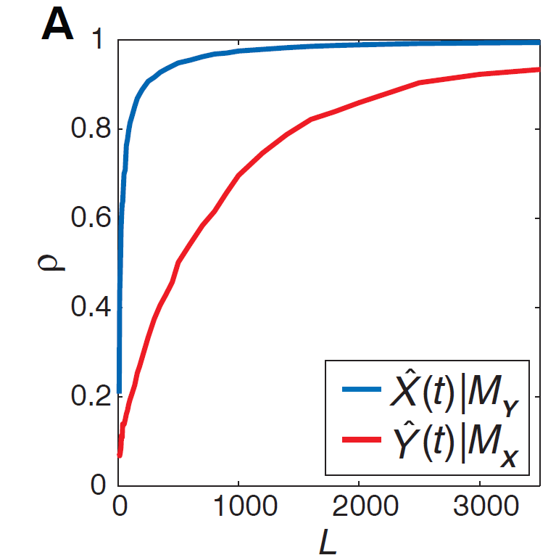
Is there causality?
Cross-map skill (rho):
Predictive ability /
Signal strength
Cross-map skill: rho
is greater than zero
Increases with training data
12.5
25
50
Passes significance tests
Library Length
(Training Data Length)

Slide 18
Considerations
CCM identifies causal relationships in weakly coupled nonlinear systems
Typically, CCM can be applied to time series of roughly 30 or more sequential observations
HOWEVER, longer time series are preferable
Particularly when causal relationships are weak or process noise and observation errors are high
With longer time series
The reconstructed manifolds are denser
Nearest neighbors are closers
Cross-map estimates (rho) increase in precision
Distinguishing causal relationships with CCM depends on
The strength of the underlying relationships
The amount of data available
The presence of process noise and observation error
Sugihara et al. 2012
Notes:
CCM identifies causal relationships in weakly coupled nonlinear systems --- most systems in ecology are weakly coupled and complex

Slide 19
Operationalizing CCM: Data Preparation
Things to do:
It is good practice to normalize time series to zero mean and unit variance to ensure all variables have the same level of magnitude for comparison and to avoid constructing a distorted state space
If data contain linear trends, these should be removed (i.e., detrended) to make the time series stationary, meaning that it should have a constant mean and variance
Strong cyclic behavior or seasonality can impact the effectiveness of CCM
Things not to do:
Time series data should not be passed through a linear filter (e.g., smoothing or moving average) because smoothers can destroy the dynamics and make the signal linear

Slide 20
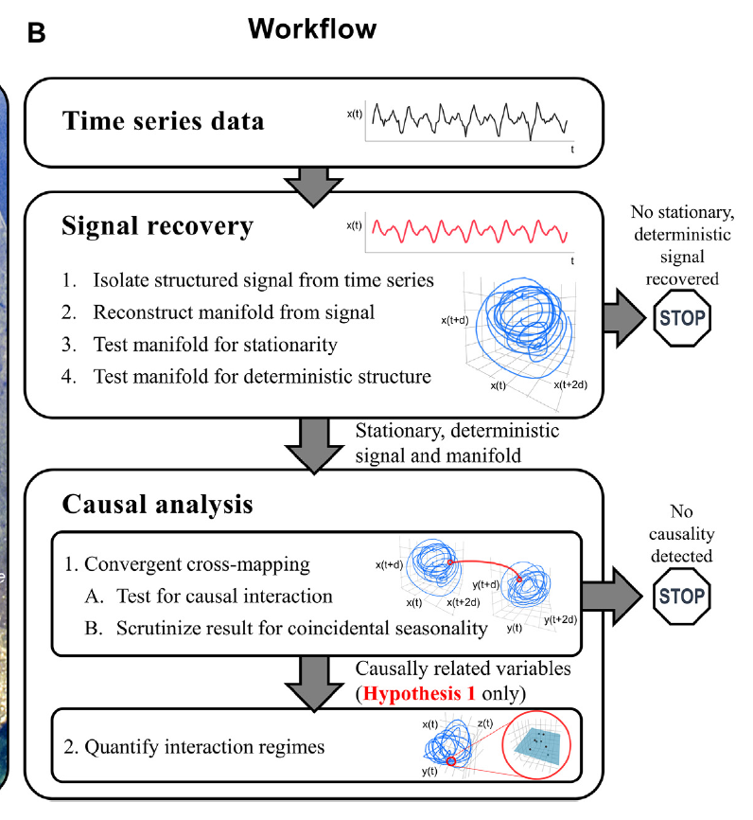
Operationalizing CCM:
4 Steps
Determine the best embedding dimension
Test for nonlinearity and stochastic noise
3. Test for causal interaction
4. Evaluate significance
Notes:
3. Calculate two processes’ abilities to describe each other’s dynamics

Slide 21
Operationalizing CCM
Step 1: Determine the best embedding dimension
Embedding dimension (E): The number of lags required to reconstruct the manifold
If enough lags are used, the reconstruction will map one-to-one to the original manifold.
If the number of lags is insufficient (i.e. the embedding dimension is too small), then the reconstruction will have singularities and the performance of CCM will suffer
Importantly, the optimal embedding dimension does not have to correspond to the dimensionality of the original system
More useful to think of E as a practical measure that optimizes the CCM and is dependent on the properties of the data

Slide 22
Operationalizing CCM
Step 2: Test for nonlinearity and stochastic noise
CCM applies in coupled nonlinear systems so it is important that the system under consideration is nonlinear AND not purely random
Predictive skill (rho) decays with increasing prediction horizon (indicating that the systemis neither completely deterministic or completely random
Predictive skill (rho) is better when accounting for nonlinearity

Slide 23
Operationalizing CCM
Step 3: Calculate the two processes’ abilities to describe each other’s dynamics
Y
X
Cross-map skill (rho):
X
Y
is greater than zero
Increases with training data
Passes significance tests
number of historical observations used to make predictions
Notes:
As the library length increases, it is more likely that previous patterns will have been observed that are similar to current patterns, which improves the predictive ability

Slide 24
Operationalizing CCM
Step 4: Test whether predictions indicate a significant causal relationship
There are 2 widely applied methods of evaluating significance
Using surrogate data to form a null distribution
Applying Mann-Kendall test to check for a monotonically increasing trend AND Fisher’s Z test to test for a difference between rho at the maximum library length and rho at the minimum library length
Both Mann-Kendall and Fisher’s Z need to be significant to assign causality

Slide 25
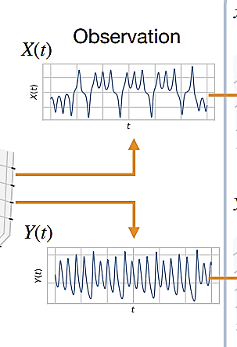
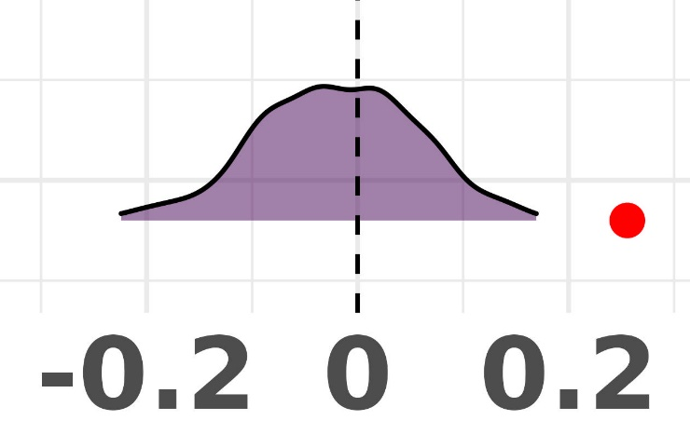
Evaluation using Surrogate Time Series
1. Using observed time series:
Can we predict X using Y?
Single
Rho value
Hypothesized cause
2. Using surrogate time series:
Can we predict randomly shuffled values of X using Y?
Null distribution of
Rho values
Hypothesized effect
Predictive Ability /
Information Transfer
Takahashi et al. 2021
Notes:
Let’s say again we have two time series and we hypothesize that X causes Y. Using CCM we will test whether we can predict the values of X from Y, which will serve as a measure of how much information from X was passed to Y. This will give us a single rho value.
We can also randomly shuffle the values of X and see if we can still predict the values of shuffled X using Y. This gives us a null distribution for our predictive ability/information transfer.
We then compare the rho value from the actual time series to the null distribution and if it is significantly different from the distributed values, we confirm that there is a causal process where X causes Y.
kEDM: A Performance-portable Implementation of Empirical Dynamic Modeling using Kokkos
May 2021
DOI:10.48550/arXiv.2105.12301
Authors:
Keichi Takahashi
Osaka University
Wassapon Watanakeesuntorn
Nara Institute of Science and Technology
Kohei Ichikawa
Nara Institute of Science and Technology
Joseph C. Park
Scripps Institution Oceanography; Okinawa

Slide 26
Evaluation using Mann-Kendall and Fisher’s Z
Y
X
X
Y
number of historical observations used to make predictions
Notes:
I favor the null distribution test, because even though it is more computationally intensive, I find it to be more robust. In my experience Mann-Kendall can give false negatives and we can go back to our illustrated example here to see why.
This is actually simulated data where we know that X causes Y. However, when we apply a Mann Kendall test here, we actually find evidence of a weakly monotonically decreasing trend. This is because what can happen sometimes is that if the rate of rho increase is high, it sometimes overshoots its convergence value a little and then slightly decreases. But if we were using the Mann-Kendall and the Fisher’s test, we would have to reject the presence of causality in this case because it did not pass the Mann Kendall test.

Slide 27
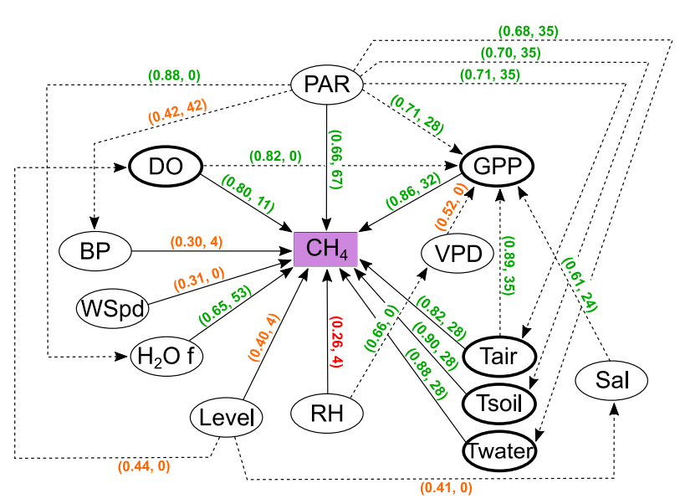
Applications: Methane fluxes in salt marshes
Gross primary productivity, dissolved oxygen, and temperature were the main forcing processes of seasonal methane fluxes
(predictive skill: rho, optimal lag time in days)
Hill et al. 2024

Slide 28
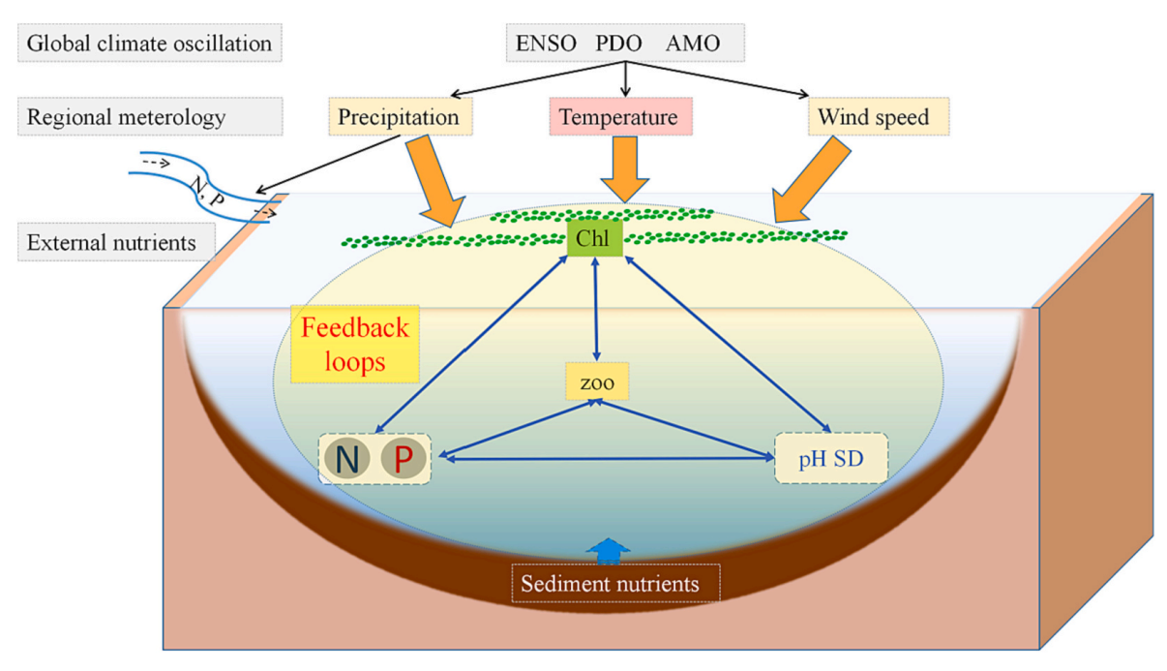
Applications: Impact of local and regional drivers on phytoplankton biomass
Quantified causal feedbacks among phytoplankton, local environment, zooplankton, meteorological conditions, and the global climate oscillation
They found a prevalence of bidirectional causality between phytoplankton biomass and the tested drivers.
Fui et al. 2024
Notes:
Phytoplankton biomass = chlorophyll
Local environment: Nitrogen, Phosphorous, secchi depth, zooplankton
Regional environment: precip, air temp, wind speed
Global: ENSO, PDO, AMO

Slide 29
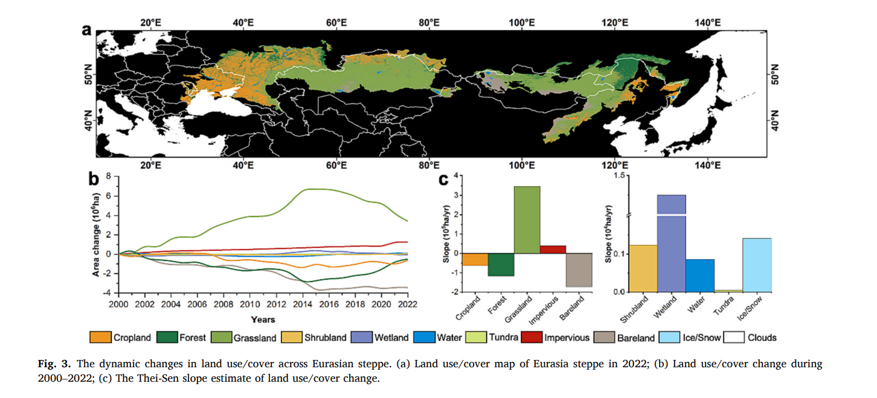
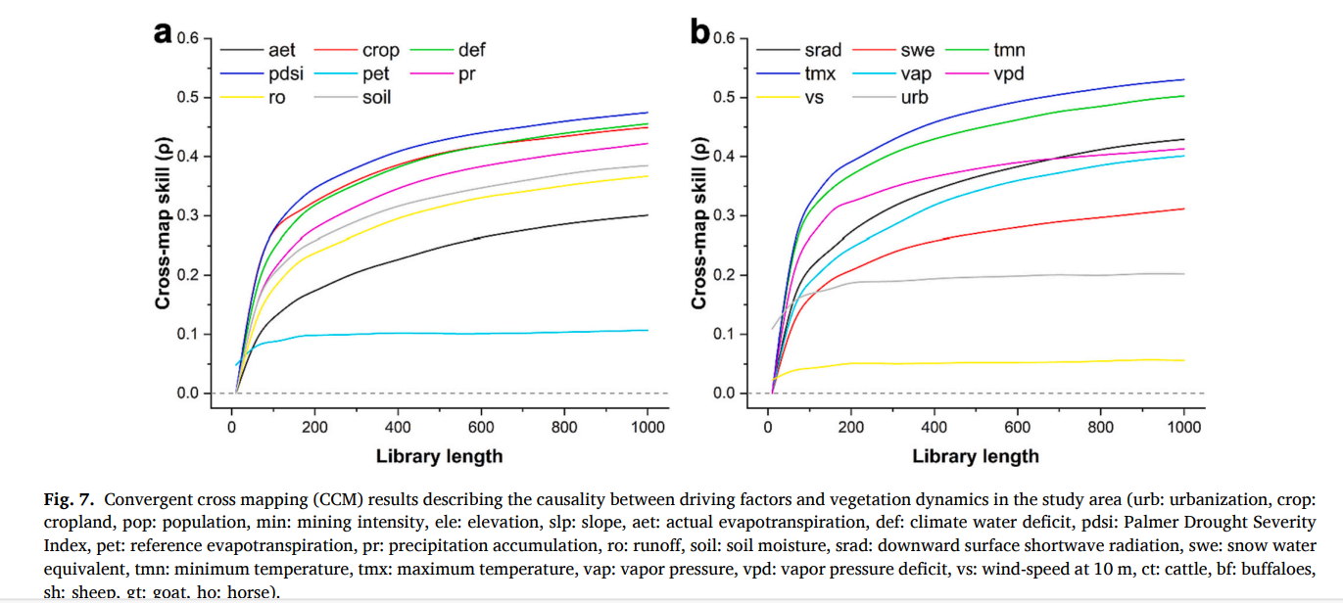
Applications: Drivers of land-cover degradation in the Eurasian steppe
Du et al. 2024
Notes:
Urbanization, cropland, population, mining intensity, elevation, slope, actual evapotranspiration, climate water deficit, palmer drought severity, reference evapotranspiration, precipitation accumulation, runoff, soil moisture, downward surface shortwave radioation, snow water equivalent, minimum temperature, vapor pressure deficit, wind speed, cattle, buffaloes, sheep, goat, horse

Slide 30
COFFEE BREAK

Slide 31
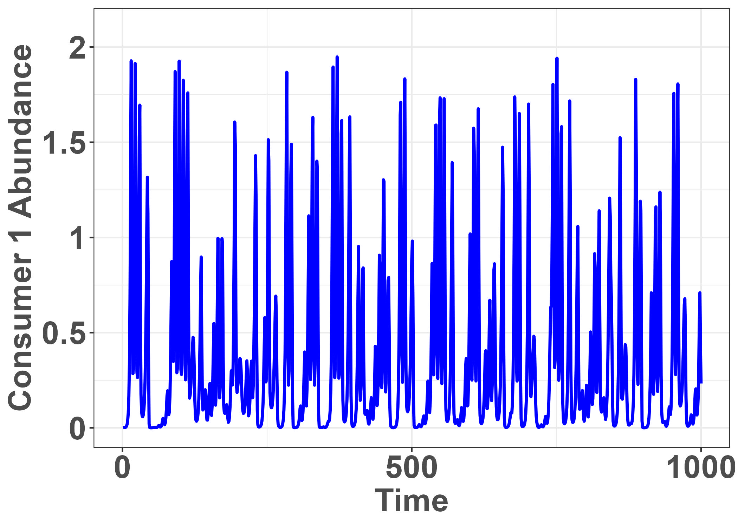
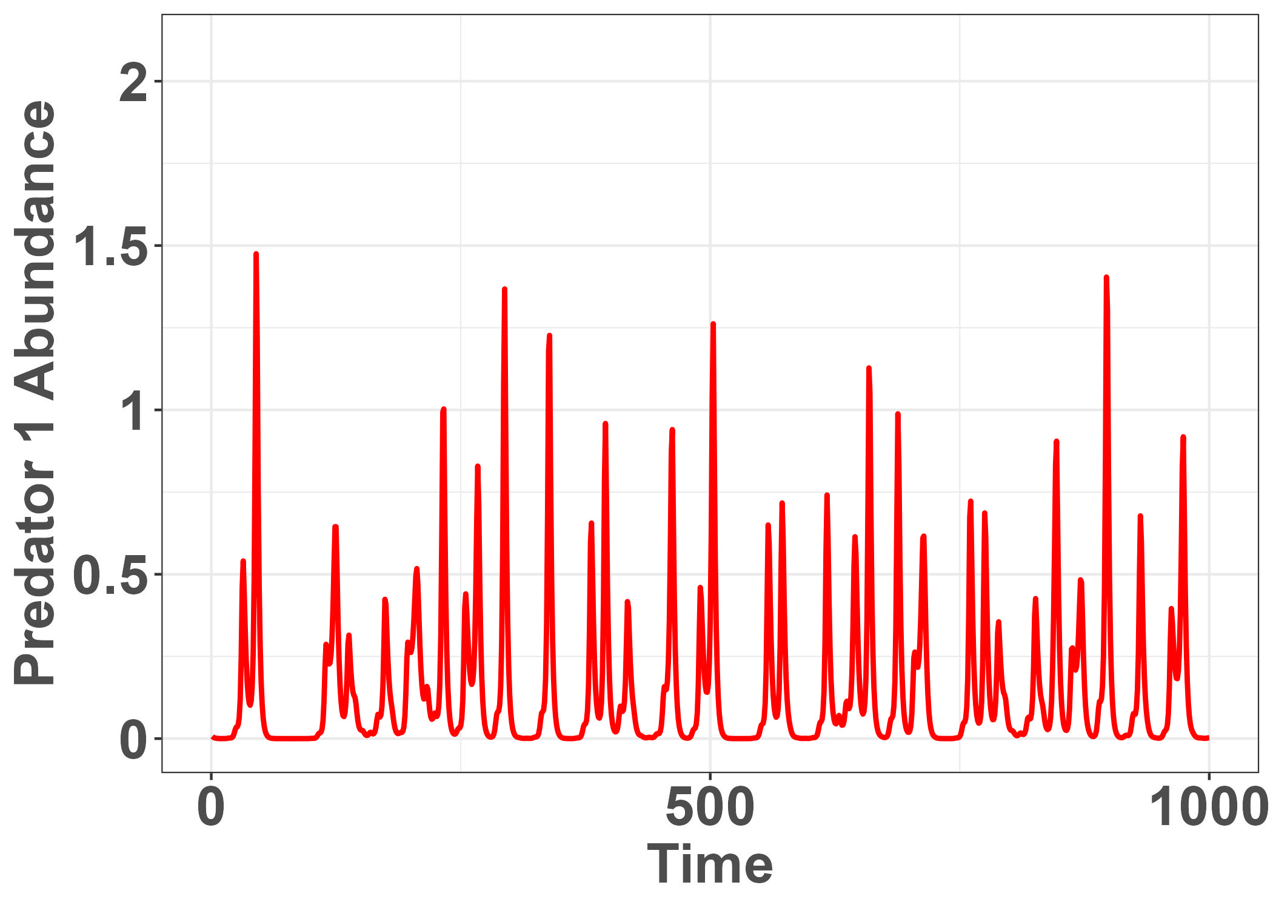
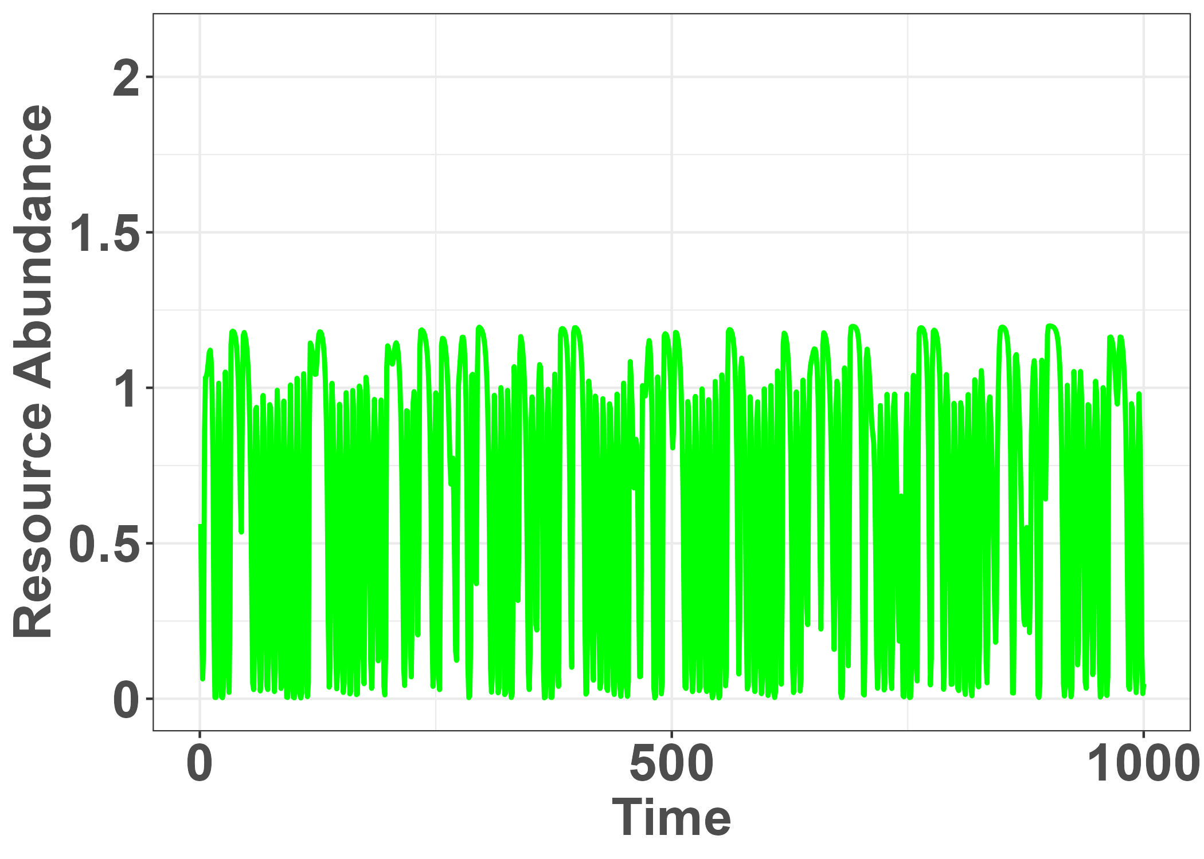
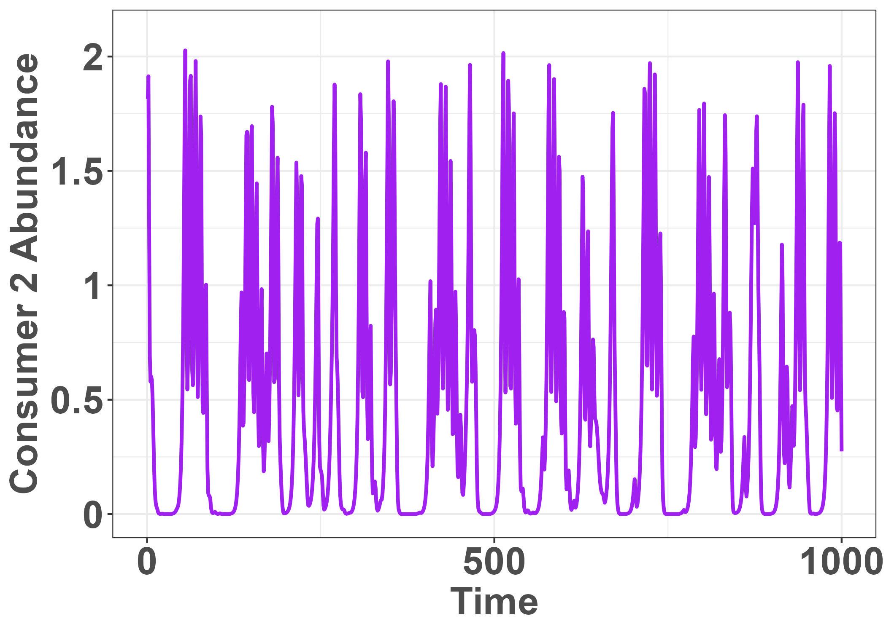
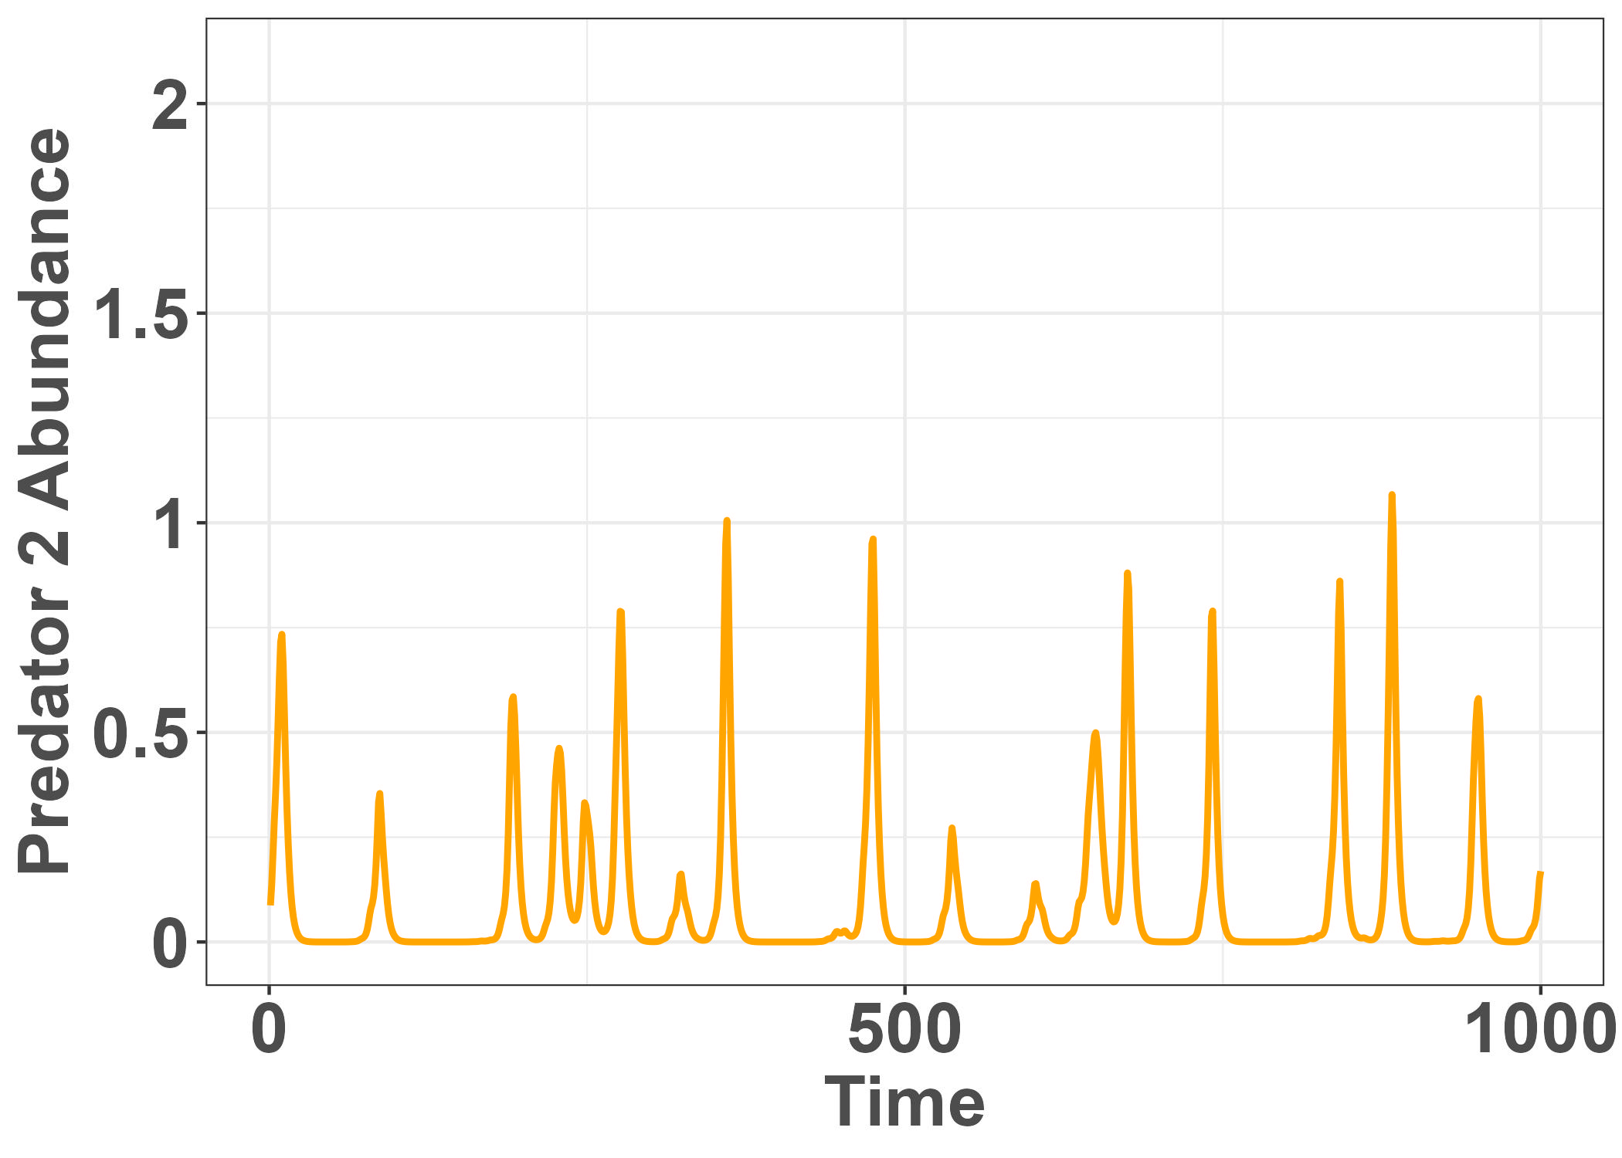
R Tutorial: Part 1
Notes:
5-component system – shared resource, consumers of the resource, predators of the consumers

Slide 32
R Tutorial: Part 1
Github repository: https://github.com/kimberlylthompson/Introduction-to-Causal-Modeling-for-Time-Series.git
We will work through 01_CCM with rEDM.R.
The simulated data is provided in a csv file
For those who are interested I also provided the script to simulate the data: 00_Simulating Abundance Data.R
All materials for the workshop are in the repo, including the powerpoint.

Slide 33
LUNCH

Slide 34
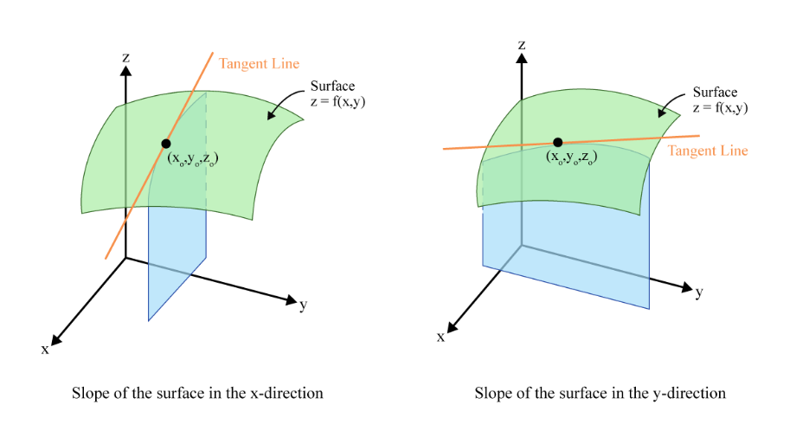
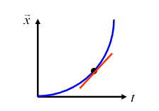
Quantifying the strength of the causality
In dynamical systems, interaction strength will vary with time
→ Need a method to account for this
Differential Calculus
First order derivative
First order partial derivative
Rate of change of one variable with respect to another variable
Rate of change of one variable with respect to another variable, with all other variables held constant
Notes:
Let’s say we have detected a causal relationship, now we want to know how strong that causation is.
In dynamical systems, interaction strength will vary through time, because the state of the system changes through time.
Critically, interaction coefficients are not constant through time, e.g. alpha ij depends on the overall state of the system
Multivariate systems
https://calcworkshop.com/partial-derivatives/partial-derivative/

Slide 35
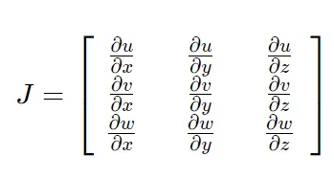
Quantifying the strength of the causality
For multivariate systems we can make a matrix of partial derivatives → Jacobian matrix
Recalculate this matrix at each successive time point
Each matrix represents the rate of change in one variable with respect to another
→ The time-varying effect of one variable on another
Example for a 3-variable system at time t

Slide 36
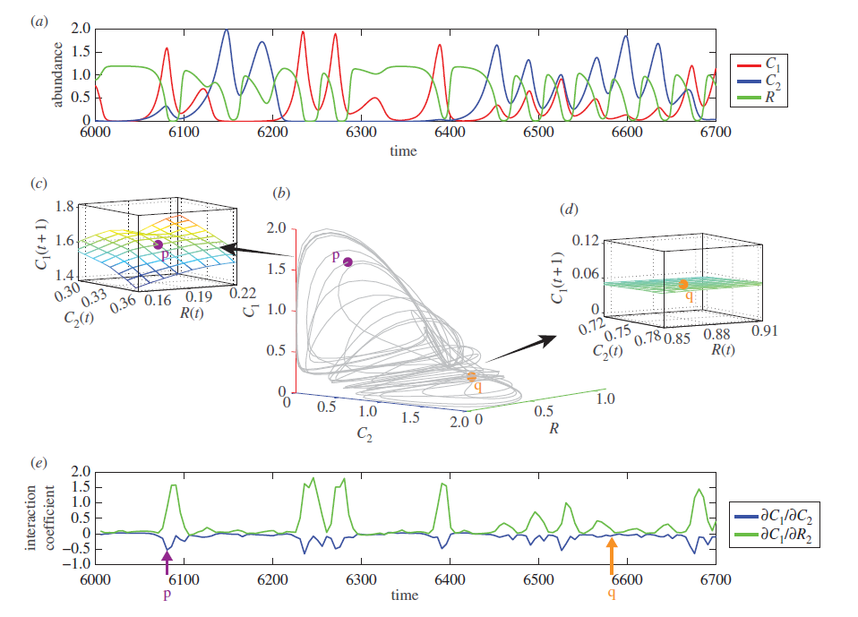
S-map
Sequential locally weighted global linear map
Deyle et al. 2016
Notes:
How do we do this when we don’t know the nature’s underlying equations to mathematically calculate the partial derivatives?
We can use S-mapping, which stands for sequential locally weighted global linear maps – which is just a long way of saying that it computes the sequential Jacobian matrices
Imagine that we have three time series – representing the abundance through time of two consumers and a resource.
Similar to what we saw before when we watched how to construct the system dynamics from component time series, we can map these time series in 3-dimensional space to see the system dynamics.
For any point, we can approximate the partial derivative using a locally weighted multivariate regression – which gives greater weights to the points on the attractor that are near the current ecosystem state. For point p for example, the surface is more curved so we will take that into account with the weighting; while for point q, the surface is flatter so the model will be closer to a linear model.
Similar to the conceptual model describing what a partial derivative is, S-map creates a hyperplane at each point as the system travels along its trajectory

Slide 37
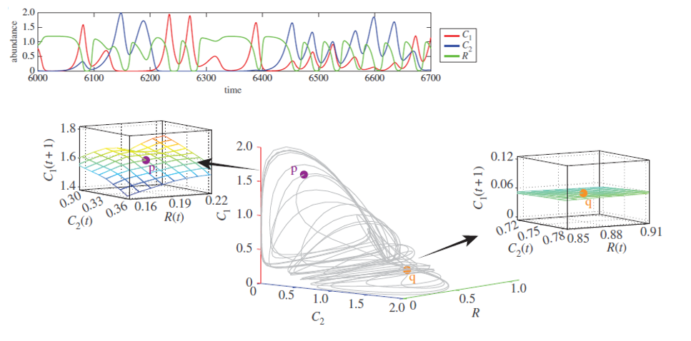
S-map
Sequential locally weighted global linear map
causal strength /
Deyle et al. 2016
Notes:
If we conduct this regression for each time point, what we get is an estimate of the interaction coefficient or the causal strength through time. Here in blue we see the causal strength of the abundance of consumer 2 on the abundance of consumer 1, and in green we see the influence of the abundance of a resource on the abundance of consumer 1.
When the lines are at zero, there is no causal influence, when positive values indicate a positive effect on abundance, negative values a negative effect.
There is code developed by Deyle et al. that I used to obtain interaction coefficients or causal strengths with this method.

Slide 38
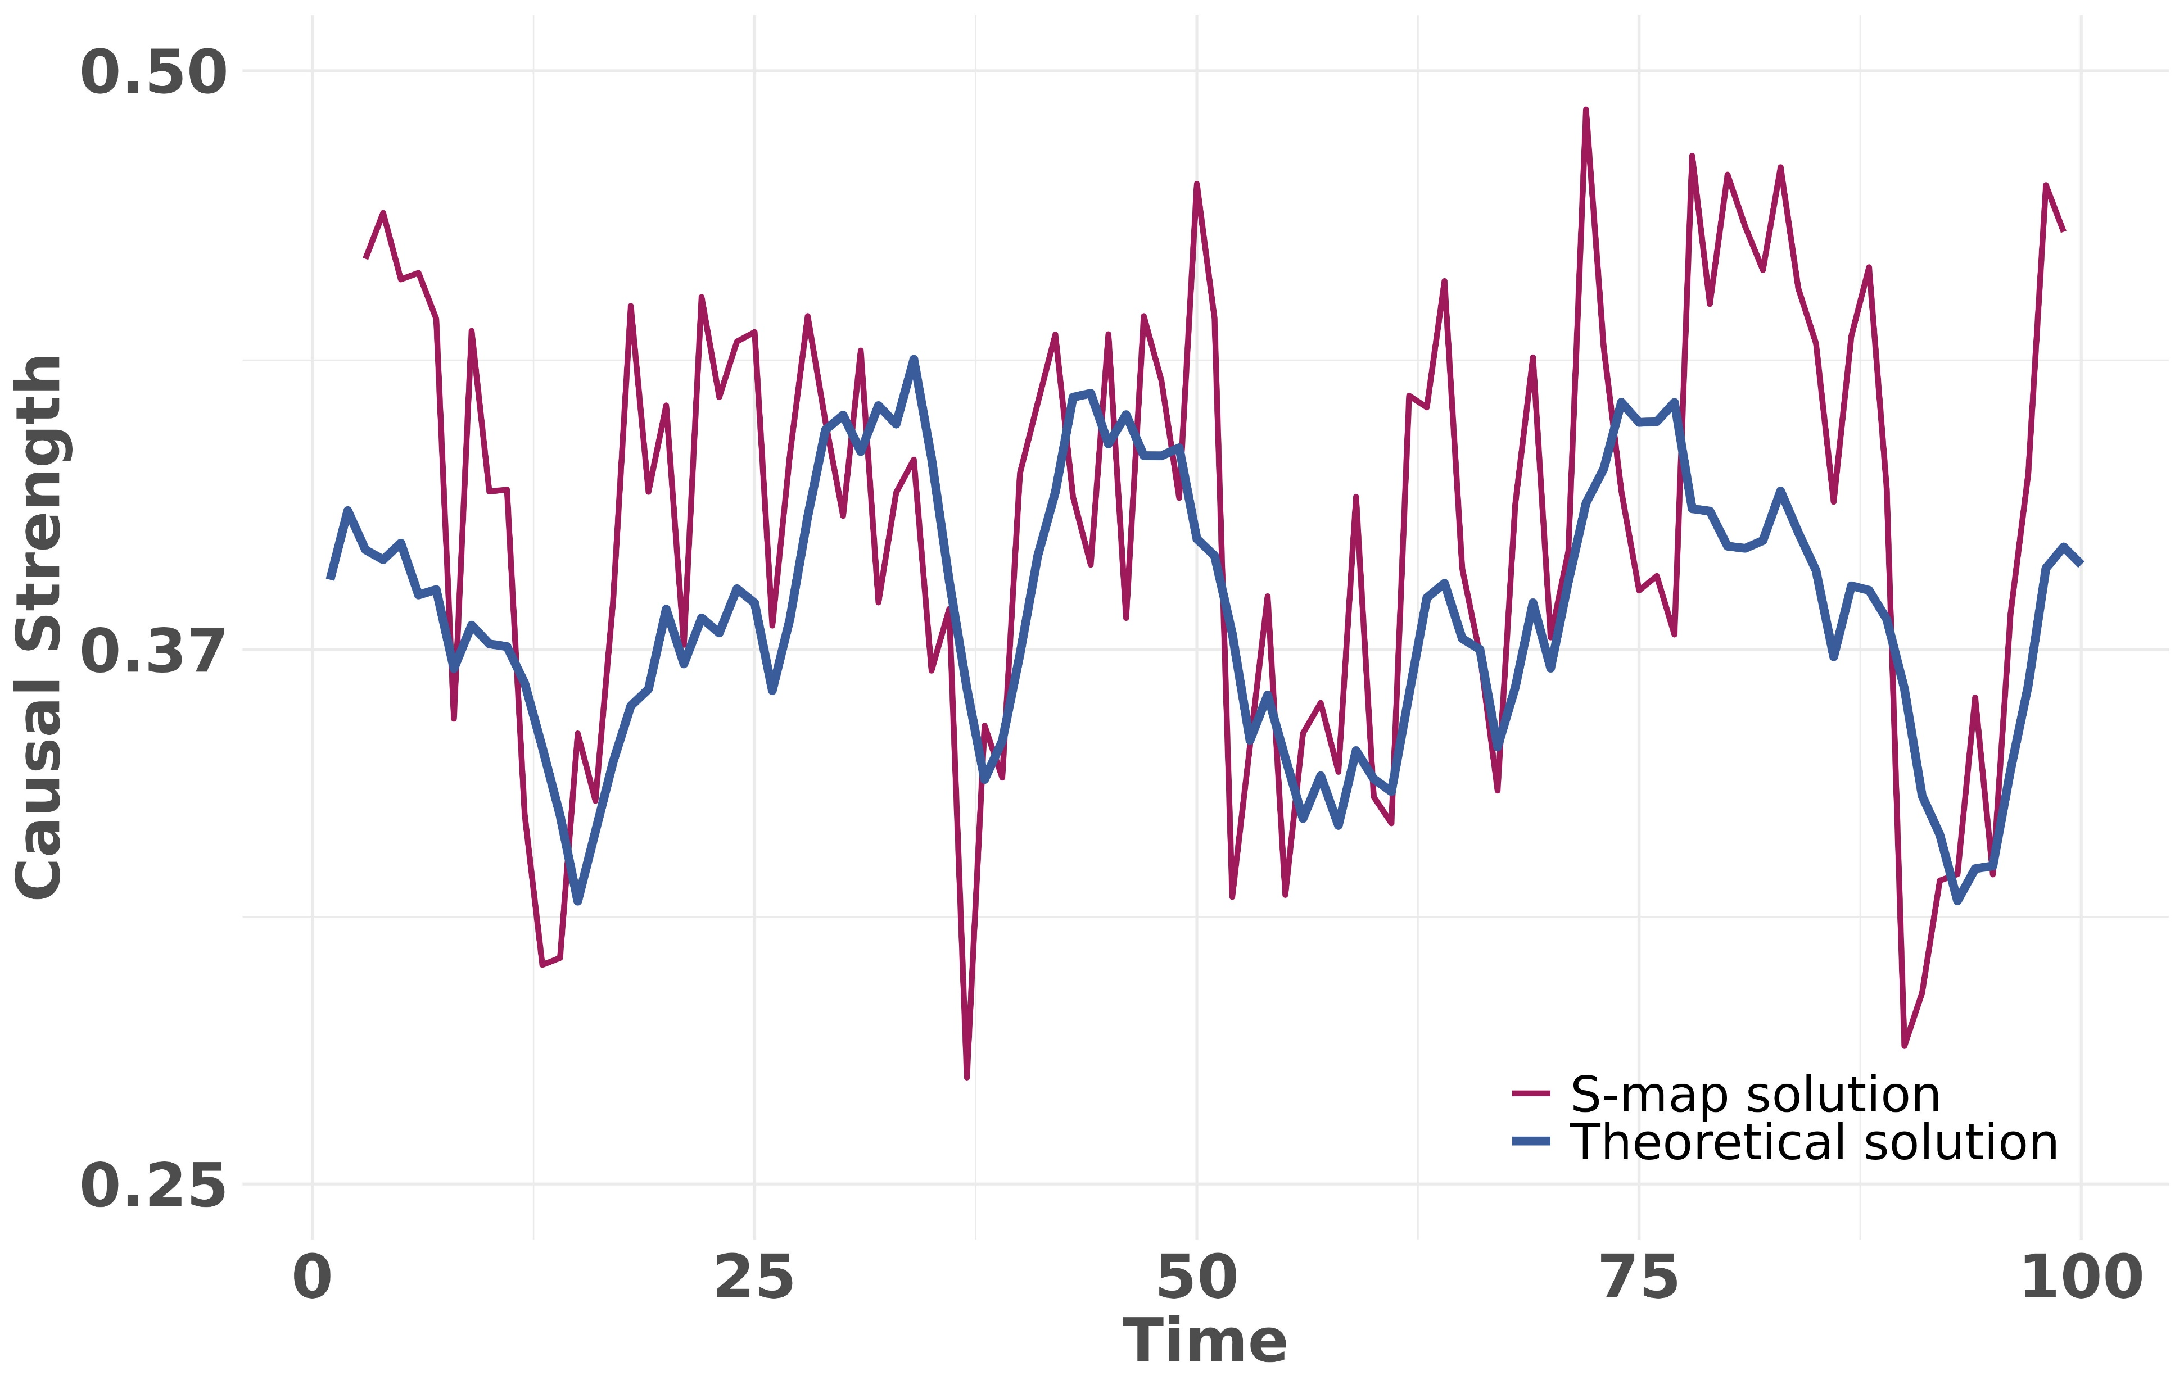
What does this look like in practice?
Notes:
Conceptual plot for 1 population of the theoretical solution vs. the Smap solution
With a process noise level of 0.1
Need to think about this a little more because the environmental dependence for this population was 0.646 so why isn’t the theoretical solution just a flat line at this level?

Slide 39
Operationalizing S-mapping
Prepare the data
Determine the optimal value of theta
First, find the optimal embedding dimension
Second, use the embedding dimension to determine the optimal theta
3. Perform the S-map

Slide 40
R Tutorial: Part 2
Github repository: https://github.com/kimberlylthompson/Introduction-to-Causal-Modeling-for-Time-Series.git
We will work through 02_Smapping.R.
The simulated data is provided in a csv file
For those who are interested I also provided the script to simulate the data: 00_Simulating Abundance Data.R
All materials for the workshop are in the repo, including the powerpoint.

Slide 41
References
YouTube videos from the Sugihara lab:
https://youtu.be/fevurdpiRYg?si=qw7mSwLTIrAgqvyz
https://youtu.be/QQwtrWBwxQg?si=E_VZqLC8Bj_uudN5
https://youtu.be/NrFdIz-D2yM?si=J-RFZtRDIB7aKWL_
Akia et al. 2023. Towards “glocalised” management of tuna stocks based on causation between a stock and its component belonging temporally to local Exclusive Economic Zones. Aquatic Living Resources: 36(23). https://doi.org/10.1051/alr/2023018.
Chang, C. et al. 2017. Empirical dynamic modeling for beginners. Ecological Research, 32(6), 785–796. https://doi.org/10.1007/s11284-017-1469-9
Clark, A. et al. 2015. Spatial convergent cross mapping to detect causal relationships from short time series. Ecology, 96(5), 1174–1181. https://doi.org/10.1890/14-1479.1
Deyle, E. et al. 2016. Tracking and forecasting ecosystem interactions in real time. Philosophical Transactions Royal Society B. 283: 2015258
Du et al. 2024. Land use/cover and land degradations across the Eurasian steppe: Dynamics, patterns, and driving forces. Science of the Total Environment: 909. https://doi.org/10.1016/j.scitotenv.2023.168593.
Gonzalez et al. 2023. A framework for the detection and attribution of biodiversity change. Philosophical Transactions Royal Society B. 378. https://doi.org/10.1098/rstb.2022.0182.
Fu et al. 2024. Weakened causal feedback loops following intensive restoration efforts and climate changes in a large shallow freshwater lake. Science of the Total Environment: 913. https://doi.org/10.1016/j.scitotenv.2023.169601.
Hill et al. 2024. Empirical dynamic modeling reveals complexity of methane fluxes in a temperate salt marsh. Journal of Geophysical ResearchI: 129(2). https://doi.org/10. 1029/2023JG007630.
Medina et al. 2022. Nitrogen-enriched discharges from a highly managed watershed intensify red tide blooms in southwest Florida. Science of the Total Environment: 827. https://doi.org/10.1016/j.scitotenv.2022.154149.
Sugihara et al. 2012. Detecting causality in complex ecosystems. Science, 338(6106), 496–500. https://doi.org/10.1126/science.1227079
Yuan, A. E., & Shou, W. 2022. Data-driven causal analysis of observational biological time series. eLife, 11, e72518. https://doi.org/10.7554/eLife.72518

